Slide 1

DIGITAL ELECTRONICS
III Semester CSE, CSE (AIML) & CSE (DS)
Dr. Ajit Kumar Patro
DEPARTMENT OF ELECTRONICS AND COMMUNICATION ENGINEERING
SCHOOL OF ENGINEERING & TECHNOLOGY
GIET UNIVERSITY, GUNUPUR, ODISHA

Slide 2
AXIOMS AND LAWS OF BOOLEAN ALGEBRA

Slide 3
Boolean Algebra
Boolean Algebra is used to analyze and simplify the digital (logic) circuits.
It uses only the binary numbers i.e. 0 and 1.
It is also called as Binary Algebra or logical Algebra.
Algebra consists of symbolic representation of a statement (generally mathematical statements).
Similarly, there are expressions, equations and functions in Boolean algebra as well.

Slide 4
Axioms or Postulates of Boolean Algebra
Axioms or postulates of Boolean algebra are a set of logical expressions that we accept without proof and upon which we can build a set of useful theorems.
Actually axioms are nothing more than the definitions of three basic logic operations that we have already discussed: AND, OR, INVERT.

Slide 5


OR Operation
0 + 0 = 0
0 + 1 = 1
1 + 0 = 1
1 + 1 = 1
NOT Operation
AND Operation
0 . 0 = 0
0 . 1 = 0
1 . 0 = 0
1 . 1 = 1

Slide 6









1. Postulate 2 : Identity
(a) (b)
2. Postulate 5 : Complement
(a) (b)
3. Theorem 1 : Idempotent
(a) (b)
4. Theorem 2 : Annulment
(a) (b)
5. Theorem 3 : Involution

Slide 7
Theorem 1
(a) A + A = A
A + A = (A + A).1
= (A + A).(A + A’)
= A + A.A’
= A + 0
= A
(b) A.A = A
A.A = A.A + 0
= A.A + A.A’
= A.(A + A’)
= A.1
= A

Slide 8
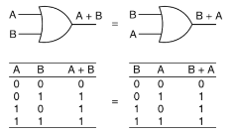
6. Postulate 3 : Commutative Law
(a) A + B = B + A

Slide 9
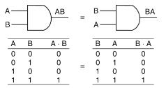
(b) A.B = B.A

Slide 10
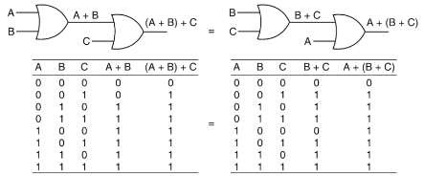
7. Theorem 4 : Associative Law
(a) (A + B) + C = A + (B + C)

Slide 11
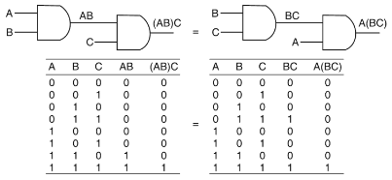
(b) (A.B).C = A.(B.C)

Slide 12
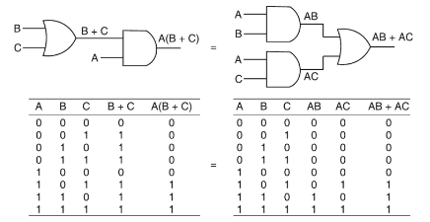
8. Postulate 4 : Distributive Law
(a) A.(B + C) = A.B + A.C

Slide 13
(b) A + B.C = (A + B).(A + C)
RHS = (A + B).(A + C)
= A.A + A.C + B.A + B.C
= A + A.C + A.B + B.C
= A.(1 + C + B) + B.C
= A.1 + B.C
= A + B.C = LHS

Slide 14
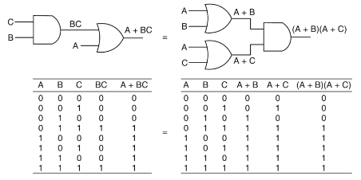

Slide 15

9. Theorem 6 : Absorption
(a) A + A.B = A
A + A.B = A.1 + A.B
= A.(1 + B) = A.1 = A

Slide 16

(b) A.(A + B) = A
A.(A + B) = A.A + A.B = A + A.B
= A.(1 + B) = A.1 = A

Slide 17

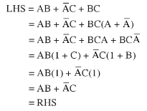
10. Consensus Theorem
Proof:

Slide 18

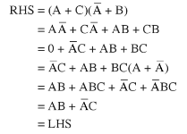
11. Transposition Theorem
Proof:

Slide 19


12. De Morgan’s Theorem
De Morgan’s Theorem states that
The complement of a sum of variables is equal to the product of their individual complements.
The complement of the product of variables is equal to the sum of their individual complements.

Slide 20
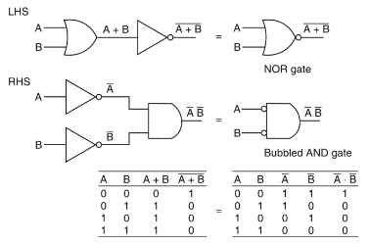

Slide 21
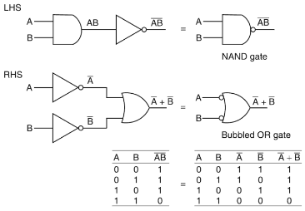

Slide 22
Duality
It states that every algebraic expression deducible from the postulates of Boolean algebra remains valid if the operators and identity elements are interchanged.
If the dual of a algebraic expression is desired, we simply interchanged OR and AND operators and replace 1’s by 0’s and 0’s by 1’s.

Slide 23
Prove that the dual of EX-OR gate is equal to its complement.
EX-OR gate : A . B’ + A’ . B
Dual of EX-OR gate : (A + B’) . (A’ + B)
= A.A’ + AB + B’A’ + B’B
= 0 + AB + B’A’ + 0
= AB + A’B’
Complement of EX-OR gate
(AB’ + A’B)’ = (AB’)’ . (A’B)’ = (A’ + B).(A + B’)
= A’A + A’B’ + BA + BB’
= 0 + A’B’ + BA + 0 = AB + A’B’

